Slide 1



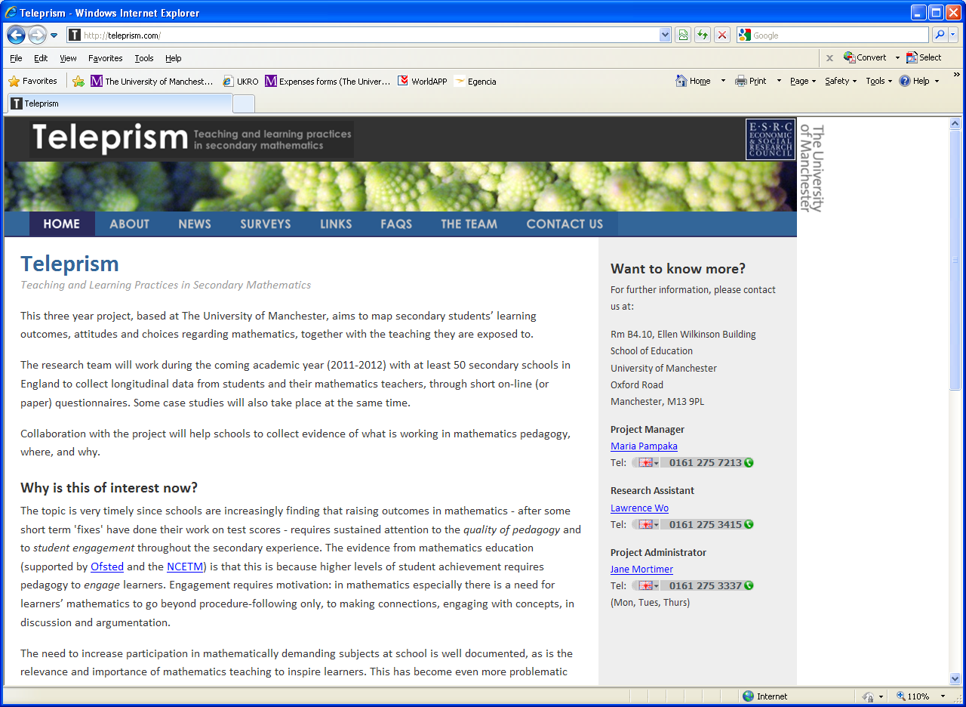
“I LIKE QUADRATIC EQUATIONS...BUT I DON’T LIKE GRAPHS”: STUDENTS’ DISPOSITIONS TOWARDS MATHEMATICS ACROSS YEAR GROUPS
Sophina Qasim, Afroditi Kalambouka, Maria Pampaka & David Swanson

Slide 2
Outline of the Presentation
Students’ dispositions to study mathematics
Using Bourdieu as a thinking tool
‘Hysteresis effect’ (see Bourdieu 1997)
2 Case studies as exemplary of such an effect
What now?
TeLePriSM

Slide 3
The project: TeLePriSM
Teaching and Learning Practices in Secondary Mathematics
“Mathematics teaching and learning in secondary schools: the impact of pedagogical practices on important learning outcomes” (ESRC: RES-061-25-0538)
Aim: To map secondary students’ learning outcomes and choices, including dispositions and attitudes, together with the teaching they are exposed to.
TeLePriSM

Slide 4
Students’ dispositions
The study of students’ dispositions is vital because this may reveal key influences on their choices and decision-making and hence future engagement with STEM (Science Technology, Engineering and Mathematics - see Mendick 2006; Reay et al. 2001; etc.).
Specifically, in this paper, we report on findings of how students’ dispositions are shaped and altered during their experiences in a school year at various time points in relation to their studies generally, future career choices, etc.
TeLePriSM

Slide 5
Habitus
The habitus is a set of dispositions, reflexes and forms of behaviour that people acquire through acting in society. It reflects the different positions people have in society, for example, whether they are brought up in a middle class environment or in a working class suburb. It is part of how society produces itself. But there is also change. Conflict is built into society. People can find their expectations and ways of living are suddenly out of step with the new social position they find themselves in … then the question of social agency and political intervention becomes very important. (Bourdieu 2000: 19)
TeLePriSM
Notes:
The habitus in relation to a field and how it attuned to a field (along with the acquisition of further capital) is very crucial to this investigation.

Slide 6
The Crisis Moment
Hernandez-Martinez & Williams (2011) say:
‘…to Bourdieu’s notion of social and cultural capital, we add this note of reflexivity: that students can develop capital through reflection, particularly in critical moments. It is that capital that allows for agency in new fields (for example, during transition), and the possibility to exercise that agency, negotiating successfully (aligning) their habituses with the conditions of the new field (resilience)’ (ibid: 6).
TeLePriSM
Notes:
Specifically, the crisis moment, which arises when the habitus does not fit the field or is ill-attuned. We particularly take on board the point made by Hernandez-Martinez (Paul) and Williams (Julian): Read.
Hernandez-Martinez and Williams (2011) explore ‘Bourdieu’s relational view of social and cultural capital as that capacity to exercise agency in a field which is (i) incorporated in the habitus, (ii) objectified in artifacts, or (iii) institutionalised (e.g. as credentials)’ (ibid: 4) in order to explore their concept of resilience as a form of agency for learners in the state of transition from one field (college) to another (University). Here resilience also arises through friction between the learner’s habitus and the field.

Slide 7
Hysteresis
In Ancient Greek, it means ‘to be late’.
The lag between the habitus - dispositions – re-adjusting itself to new opportunities in the field (see Bourdieu, 1997).
TeLePriSM
Notes:
In Ancient Greek, it simply means ‘to be late’
If you put in google search engine just the word hysteresis, you will come up with certain physics and mathematics definitions describing the phenomena of coming behind…when the effect of something carries on even when the cause is over.

Slide 8
Hysteresis contd.
Bourdieu states:
…as a result of heightened consciousness associated with an effort of transformation (such as correction of accents, manners, etc.), there is an inertia (or hysteresis) of habitus which has a spontaneous tendency (based in biology) to perpetuate structures corresponding to their conditions of production…But, more generally, the diversity of conditions, the corresponding diversity of habitus and the multiplicity of intra- and intergenerational movements of ascent or decline mean that habitus may, in many cases, be confronted with conditions of actualization different from those in which they were produced. (ibid: 160-161).
TeLePriSM

Slide 9
Hysteresis contd.
So the crisis moment can lead to two potential outcomes:
One in which the conditions of existence of the habitus in the first place are re-perpetuated, leading to the non-acquisition of the new positions and missed opportunities. This is most likely to happen to agents who cling to their old dispositions: “this is not for the likes of me”.
The other in which the inertia of the habitus is quick to respond to new opportunities intra-generationally
TeLePriSM
Notes:
Now I would like to explore this through some extracts of the narratives constructed for the two case studies.

Slide 10
CS1 - Julie (F, Yr 10, Set 1- Maths)
Background:
… we are all very similar, and they all did languages at both GCSE and A level and all did English at A level as well. So we are all kind of similar in that context, so it is good having them in there… because they can tell me what it is like and things like that.
TeLePriSM
Notes:
Julie is a Yr 10 student, top set in maths. Her dad is a counsellor and University lecturer and her mum is a social worker. She holds an interest in languages just like her siblings. This is what she says about her siblings:

Slide 11
CS1 - Julie (F, Yr 10, Set 1- Maths)
Future career choices:
I know I definitely want to go to University. I don’t have a view of what I want to do in the future. I will probably carry on with my English and history because I like them.
TeLePriSM
Notes:
The above shows that Julie’s dispositions towards learning (including her choices of subjects) reflect her family’s influence (which we class as cultural capital). She herself is quite aware of her position, for example, in the mathematics class (field) as she describes herself as: ‘quite good at Maths’ and ‘highest in the class’ without trying ‘to sound really big headed’. In terms of maths learning, she says:
Although she does specify in an interview later on that she would like to study medicine at Uni.

Slide 12
CS1 - Julie (F, Yr 10, Set 1- Maths)
Things just register in my brain easily in maths, so I don’t find it hard to learn new things, they click quite easily.
I find it easier to do the – if it is a calculated paper, a calculated question in a quadratic equation because everything is there for you, you can work it out and you don’t really need to think about which numbers to put in whereas if you just factorise it into 2 brackets, then you have to think about what numbers you have used to do this and it could take more time then, that just using the equation and working it out straight away…
TeLePriSM

Slide 13
CS1 - Julie (F, Yr 10, Set 1- Maths)
Why?
If we were doing simultaneous equations for example, Miss will either do it as a table or in partners and she will give us shapes and then match them up and make a big shape and do all the matching. (…) or the formula of something and then match it with the actual formula and that helps because it makes things stick in your brain, we do that and have been doing that since Year 8 and we have been doing that quite a lot. Or if we have finished a topic like trigonometry she will get a big poster with all the different things on it, just to sum up everything we have done and just to check that we know everything. If we don’t or people struggle then she will like go over it with us and we do that quite a lot.
TeLePriSM
Notes:
Reasons as to why she takes to this type of algebra can be deduced from this quote. (Point to quote).
These pedagogical approaches seem to be student-centered and favoring Julie’s learning process.

Slide 14
CS1 - Julie (F, Yr 10, Set 1- Maths)
At the same time, Julie has a dislike for graphs:
I don’t like doing graphs; they are just time consuming. It is just the way they look on the page, sometimes they look easy, but other times you look at them and you have no idea what they are about.
TeLePriSM
Notes:
It certainly raises the question what is it about graphs that makes Julie dislike them.

Slide 15
CS2 - Mark (M, Yr 9, Set 2- Maths)
Background:
Moved from Philippines during Yr 6.
His dad came to find work in the UK.
‘So my family came to find a better life here’.
TeLePriSM
Notes:
Mark is a Yr 9 student, 2nd top set in maths. Mark’s story (a Year 9 student – 2nd top set in his mathematics class) is different in the sense that he wasn’t born and raised in the UK. He joined the UK during Year 6 and is originally from the Philippines. His family left the Philippines after his dad found work in the UK.

Slide 16
CS2 - Mark (M, Yr 9, Set 2- Maths)
Future career choice:
They would want me to be in nursing because they keep telling me (…) people get sick all the time (…) it’s not like other jobs’. However, the focus is on nursing rather than other medical professions: ‘just that field, not really a doctor’.
TeLePriSM
Notes:
His family’s interest in nursing is also quite apparent. His mum used to be a ‘teacher at the nursing University’ and his grandmother was the ‘Head-Dean’ at his ‘mum’s work place at the University’. Now here they are not working due to work visa restrictions. And they also push him towards nursing.
That, however - as Mark insists, would not mean that he would follow into the nursing profession. Instead he is thinking about ‘aeronautics’ or something else as he says: ‘there is a whole world out there just waiting’

Slide 17
CS2 - Mark (M, Yr 9, Set 2- Maths)
‘There is a whole world out there just waiting’.
TeLePriSM
Notes:
However, Mark says that there is a whole world out there waiting.
So far it is evident in his account that Mark and his family experienced the hysteresis effect i.e. the lag between the habitus adjusting to a new field due to transition from one country to another. Whereas he sees the new opportunities and wants to avail them (in terms of future choices), it is also obvious from his account that his family does not see, for example, any choices made outside of the profession of nursing suitable to them. So here we have a case where his parents are subjected to the inter-generational effects of hysteresis, whereas, Mark seems to be able to move away from that viewpoint.

Slide 18
CS2 - Mark (M, Yr 9, Set 2- Maths)
Impact on maths learning:
Maths is not my favourite subject in the world but I am progressing. I have seen an improvement in my grades lately from going from I used to do really, really bad to being 5A, but now I am really going into the level 7, 6b, 6A and 7C, so I am doing quite good in maths.
TeLePriSM

Slide 19
Summing Up
What is it about ‘graphs’ that makes Julie dislike them or prompt a ‘crisis moment’?
Does Mark’s crisis moment create room for agency enabling him to improve his own maths learning?
Thank you.
TeLePriSM
Notes:
I am going to try and not repeat some of the arguments that I have already stated but pose questions that might spark a discussion.
What is it about ‘graphs’ that makes Julie dislike them or prompt a ‘crisis moment’?
Arguably, This may point to the dominant pedagogy, which automises and separates elements of mathematics that creates more opportunities for the hysteresis effect to happen; that, perhaps, wouldn’t occur if mathematics would be taught more in a connected and integrated way.
Does Mark’s crisis moment create room for agency enabling him to improve his own maths learning?
Arguably, the friction between his old habitus (and the cultural capital of his family) has allowed him to develop a distinct form of educational capital and acquire new dispositions, in other words, exercise a form of agency. This is partly due to his ability to be reflexive as a learner. The notion of hysteresis is explored further in our upcoming presentation in ECER in Spain in two weeks time, where we try to provide a characterisation of Holland’s book ‘identity, agency and practice’ and the characterisation of Bourdieu in it.

Slide 20
References
Bourdieu, P. (1997). Pascalian Meditations. Cambridge: Polity.
Bourdieu, P. (2000). The politics of protest. An interview with Kevin Ovenden. Socialist Review #42
Hernandez-Martinez, P. and Williams, J. (2011). Against the odds: resilience in mathematics students in transition, British Educational Research Journal, Online First: Taylor & Francis.
Mendick, H. (2006). Masculinities in Mathematics. Berkshire: Open University Press.
Reay, D., Ball, S. J., David, M., & Davies, J. (2001). Choices of degree or degrees of choice? Social class, race and the higher education choice process. Sociology, 35(4), 855-874.
TeLePriSM

